Slide 1
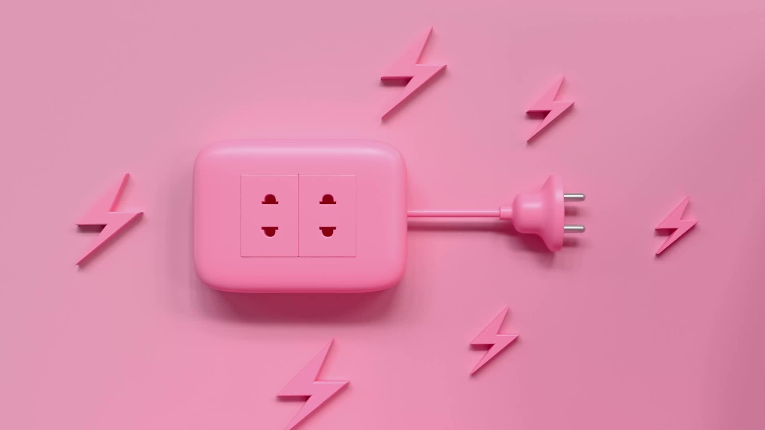
3 Lead ECG
Audra Xenakis, BSN, RN
Health & Illness III

Slide 2
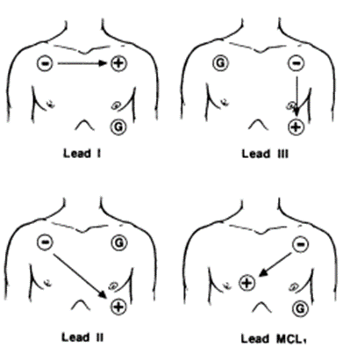
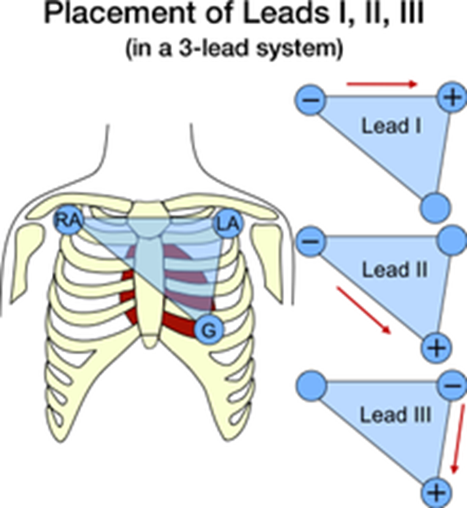
Right
Left
Right
Left
Leads read from negative to positive.
Right
Left
Lead II is used most.

Slide 3


As cardiac electric activity is occurring, the ECG is viewing and recording it.
The different Lead placements, provide different "camera views" of what the lead is viewing.

Slide 4
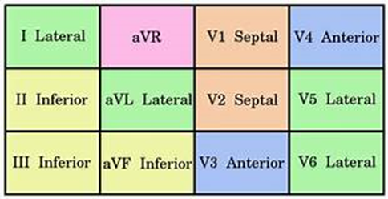
As cardiac electric activity is occurring, the ECG is viewing and recording it.
The different Lead placements, provide different "camera views" of what the lead is viewing.

Slide 5
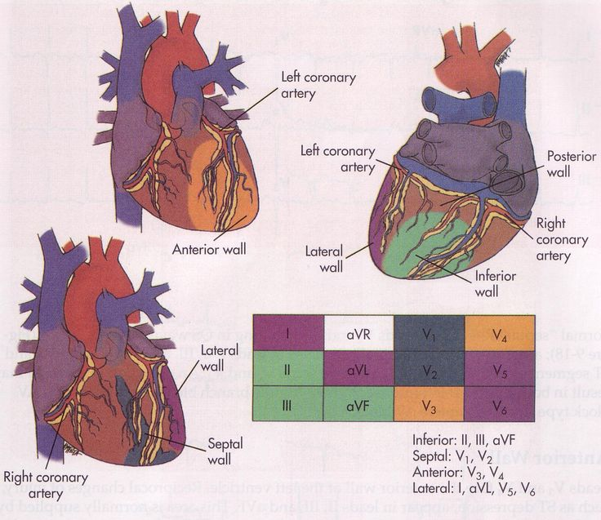

Slide 6
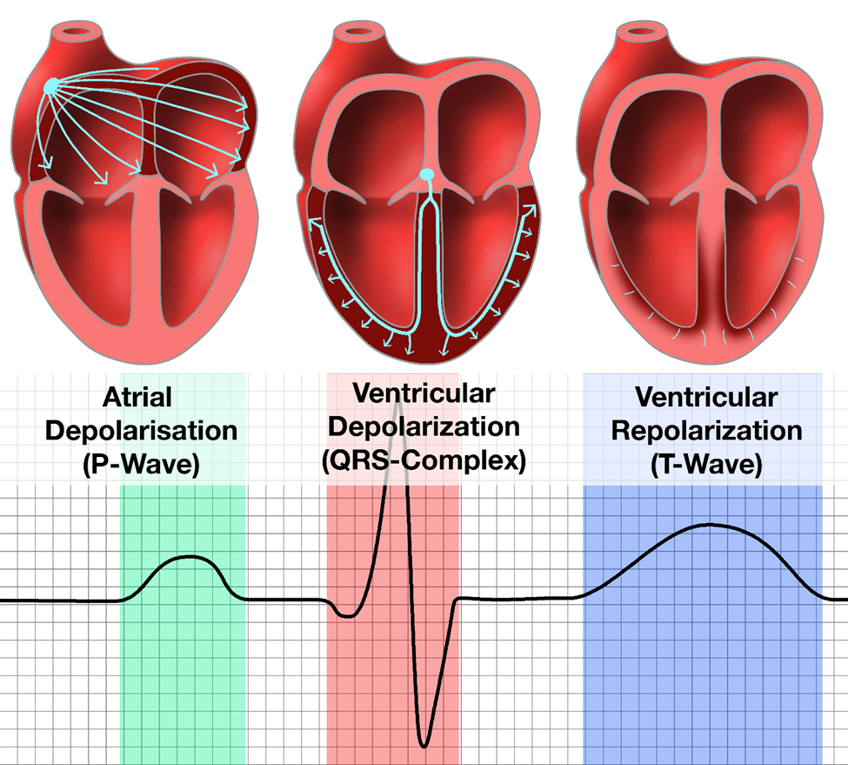

Slide 7
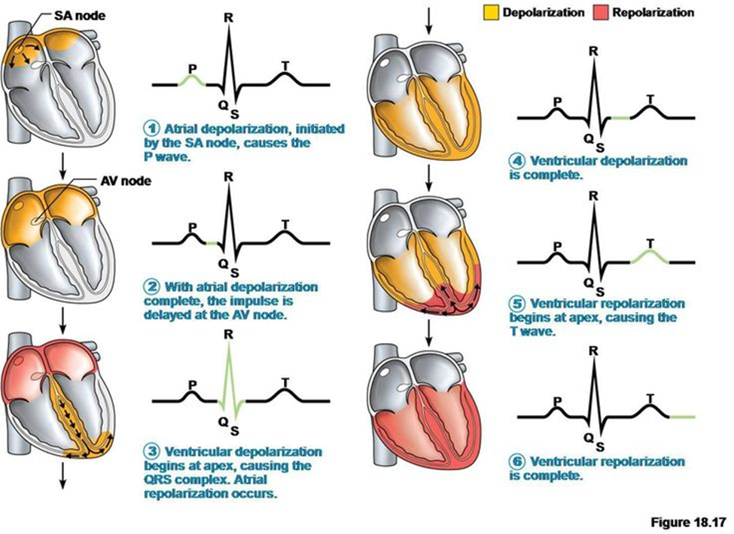

Slide 9
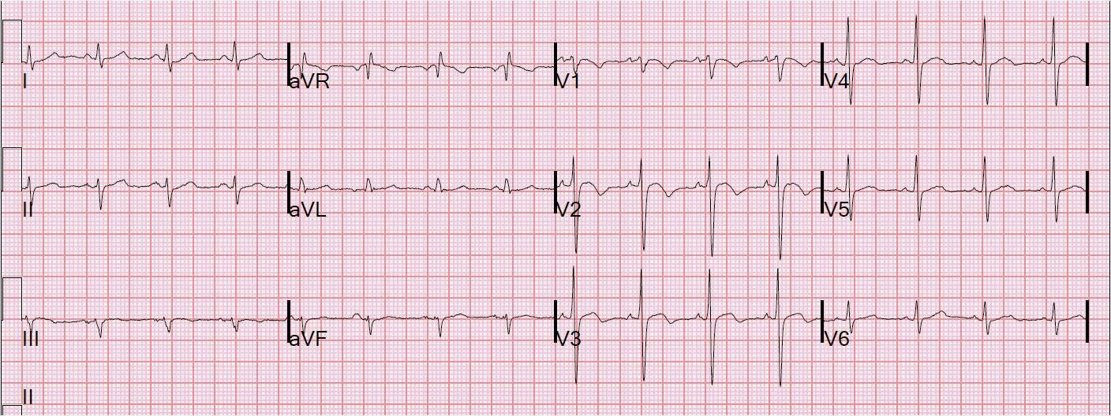

Slide 10
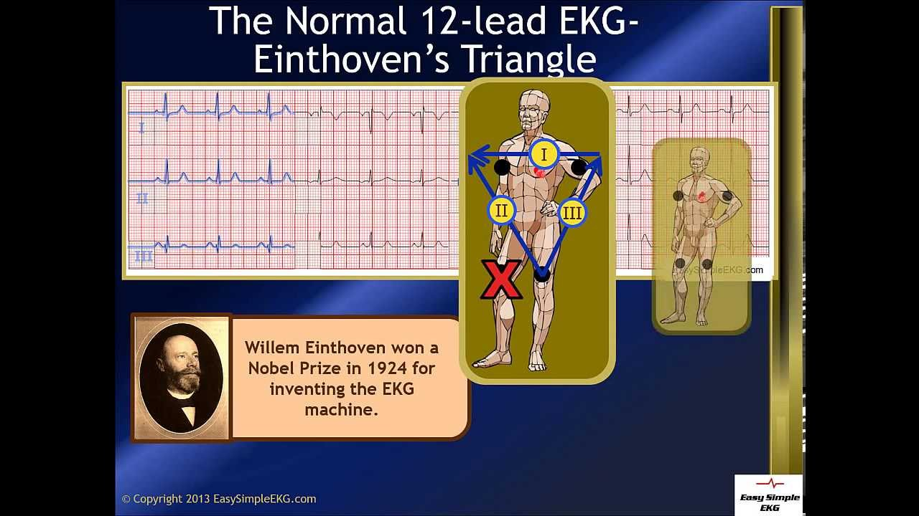

Slide 11
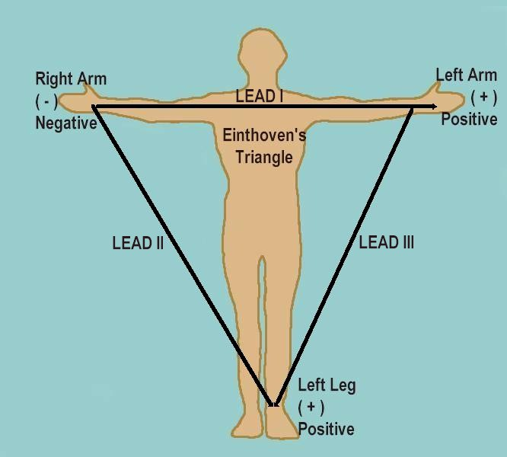
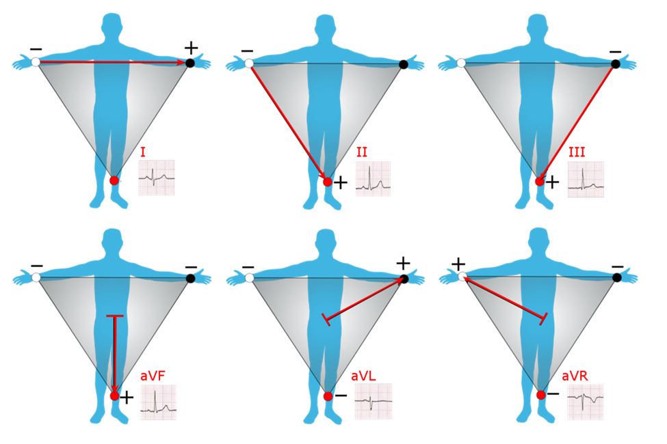

Slide 12
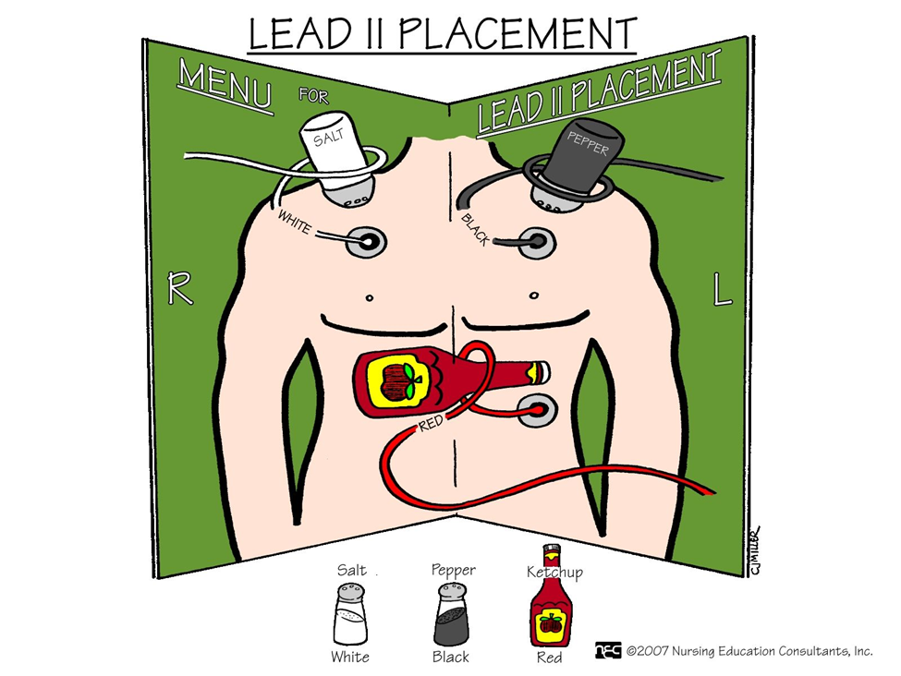

Slide 13
